Slide 1


Educational Data Mining:
Discovering Principal Factors for Better Academic Performance
Yucheng Jin, Xiaomeng Yang, Chengting Yu, Prof. Liangjing Yang
BDET 2021
June 23, 2021
ZJU-UIUC Institute © 2020-2021 Yucheng Jin. All rights reserved. Slide

Slide 2

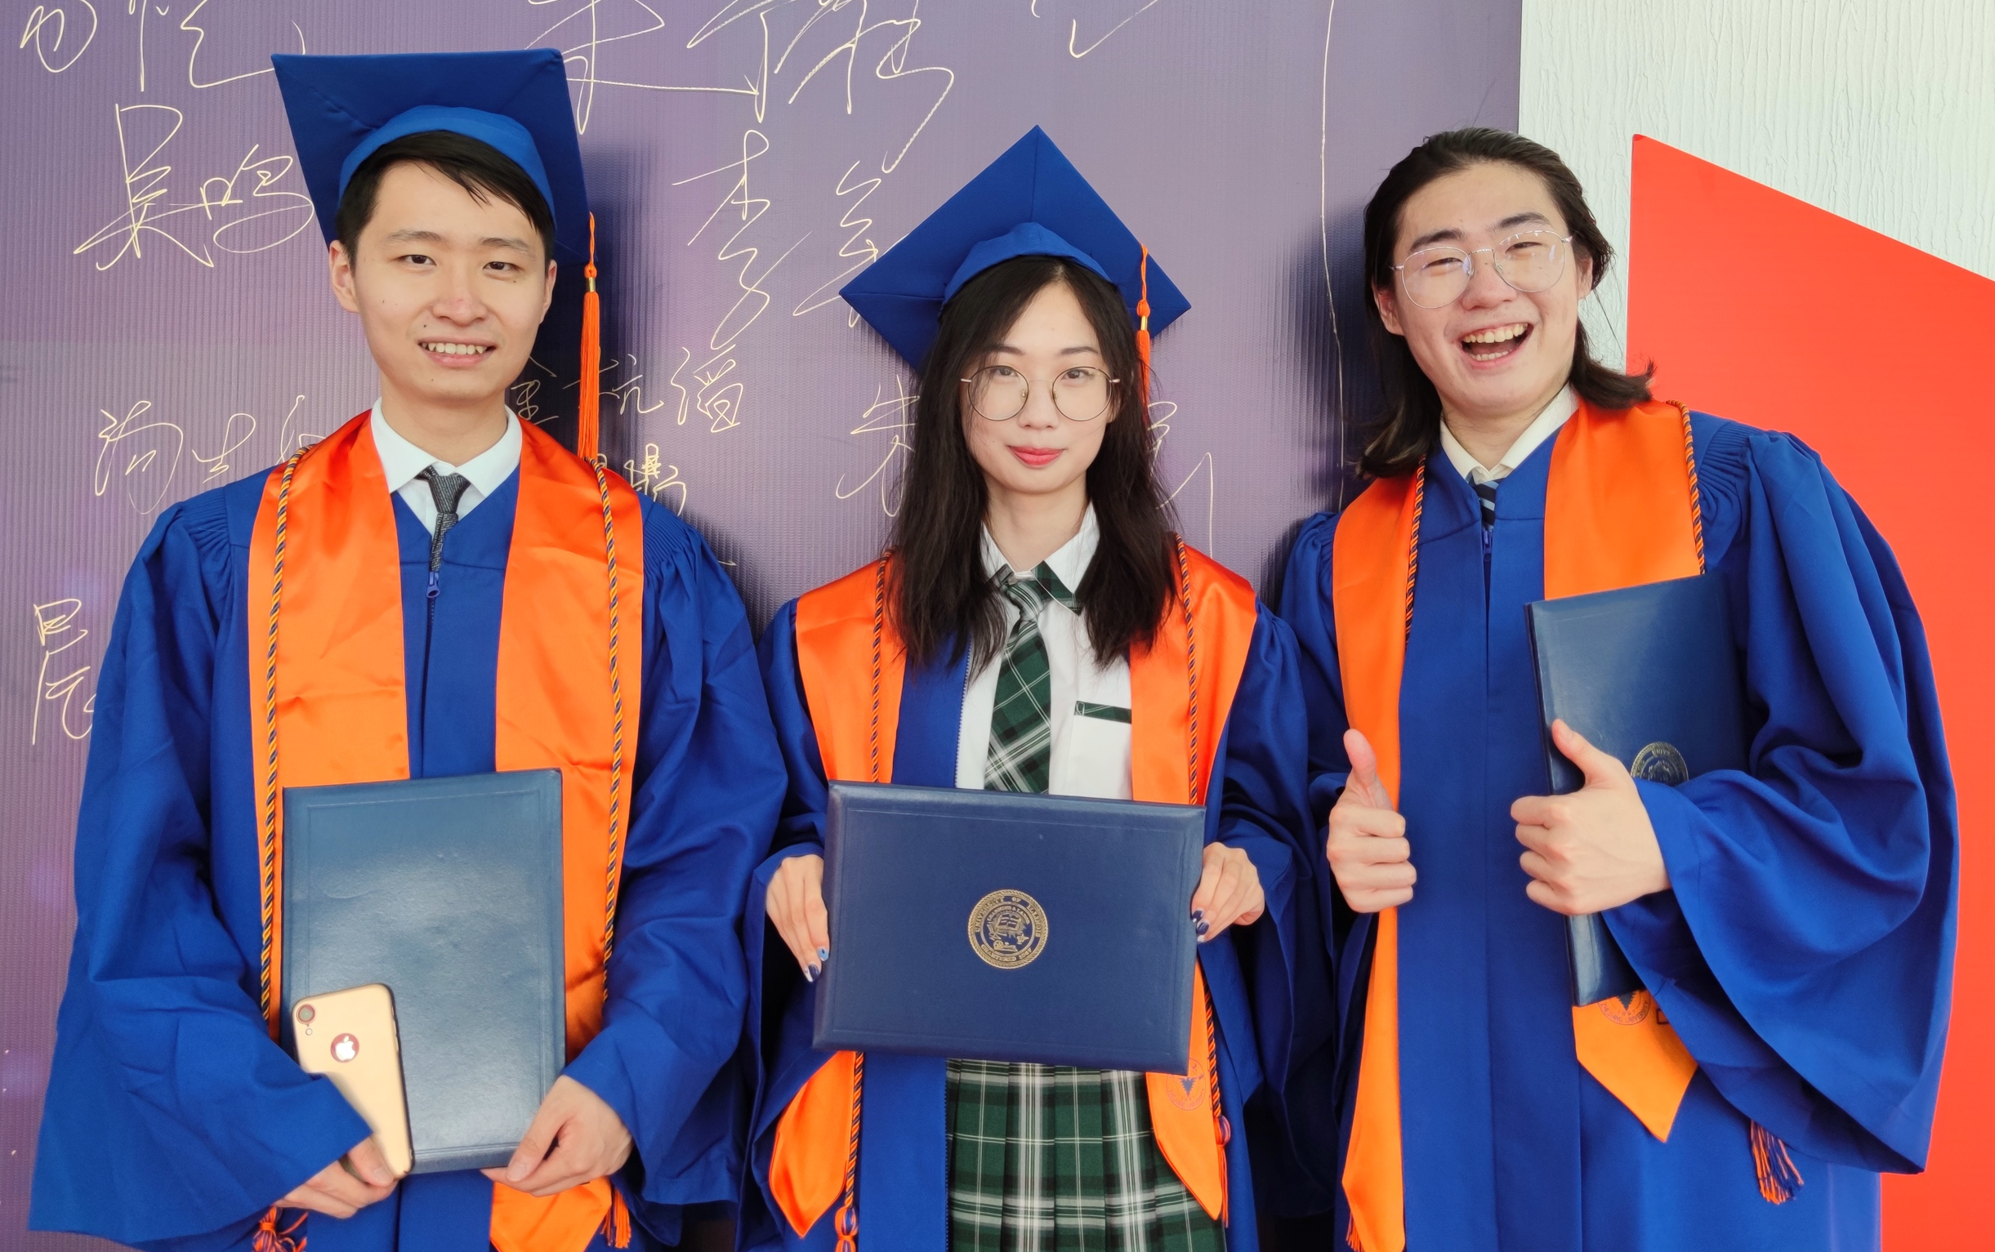
Authors
Student Authors
Yucheng Jin (left), Computer Engineering undergraduate at ZJU-UIUC Institute, he will continue his graduate study at UC Berkeley. He is the team leader, his major contributions are data collection and preprocessing, model optimization, and paper writing.
Xiaomeng Yang (middle), Computer Engineering undergraduate at ZJU-UIUC Institute, she will continue her graduate study at Chinese Academy of Science. Her major contribution are model construction and paper writing.
Chengting Yu (right), Computer Engineering undergraduate at ZJU-UIUC Institute, he will continue his graduate study at Zhejiang University. His major contributions are literature review and data preprocessing.
ZJU-UIUC Institute © 2020-2021 Yucheng Jin. All rights reserved. Slide

Slide 3

Authors
Advisor
Dr. Liangjing Yang is the advisor of this study. He is an assistant professor at ZJU-UIUC Institute and a member of BDET 2021 technical committee. His research interests are robotics, computer vision, and vision-guided micromanipulation.
ZJU-UIUC Institute © 2020-2021 Yucheng Jin. All rights reserved. Slide

Slide 4
Introduction
Educational Data Mining (EDM)
Educational data mining (EDM) applies data mining, machine learning, and statistical tools and techniques to discover useful knowledge from education-oriented databases.
Specifically, after preprocessing of in-class and off-class data, such as students’ test scores and teachers’ feedback, various data mining techniques can be applied to discover key patterns and extract principal factors for educational purposes [1].
During the past decades, EDM has played a remarkable role in pedagogical improvement [2].
Objective, Methodology, and Result
This study is a comprehensive and quantitative investigation into the principal factors that influence Chinese junior high school students’ academic performance.
We use a variety of data mining strategies, including linear regression, regression tree, random forest, and neural network on the China Education Panel Survey (CEPS) dataset; then summarize, explain, and compare different principal factors discovered by different EDM techniques.
ZJU-UIUC Institute © 2020-2021 Yucheng Jin. All rights reserved. Slide

Slide 5
Related Work
Applications of EDM
Al-Radaideh et al [3] implement decision tree and Naïve Bayes algorithms to predict the final grades of students learning C++ at Yarmouk University in Jordan.
S. K. Yadav et al [4] utilize three decision tree algorithms, namely, ID3, C4.5, and CART, to predict the academic performance of students at VBS Purvanchal University in India.
Based on [4], Bharadwaj and Pal [5] further emphasize the importance of data selection and transformation.
Han and Kamber [6] describe some convenient data mining tools that allow efficient analysis of collected educational data, which are helpful in feature selection and data categorization.
Peña-Ayala [7] reviews the development of EDM while compares the strengths and weaknesses of different data mining models, showing both advantages and limitations of each model in specific situations.
ZJU-UIUC Institute © 2020-2021 Yucheng Jin. All rights reserved. Slide

Slide 6
Data Preparation
China Education Panel Survey (CEPS)
China Education Panel Survey (CEPS) is a nationally representative survey.
CEPS has 10,279 questionnaires collected from students, parents, teachers, and school principals for the 2014-2015 academic year.
Specifically, after preprocessing of in-class and off-class data, such as students’ test scores and teachers’ feedback, various data mining techniques can be applied to discover key patterns and extract principal factors for educational purposes [1].
Data Preprocessing
Raw dataset contains redundancies and missing data, data selection is the first step of the data processing procedure.
After data selection, we determine target variables and input features for regression based on Xu and Li’s metrics [8], followed by the standardization of data.
Students’ exam scores and cognitive test scores are selected as the target variables for academic performance evaluation, while the input features are classified as three categories: demographic and family background information (Demographic), self-perceived willingness for education (Willingness), and perceived family interaction (Interaction).
ZJU-UIUC Institute © 2020-2021 Yucheng Jin. All rights reserved. Slide

Slide 7
Data Preparation
Key Quantitative Metrics
• Demographic and family background information (Demographic):
These variables include the family economic conditions, ethnic identity of parents (Han Chinese or ethnic minority), family Hukou (status of household registration), and other data related to basic information about students and their parents.
• Self-perceived willingness for education (Willingness):
Students and their parents were asked to answer the academic goals, expected highest level of education, and ideal future occupation.
• Perceived family interaction (Interaction):
Questions such as “How is the general relationship between you and your father/mother?” and “What do you usually do when this child and you have different opinions?” explicitly reflect the intimacy between family members.
Table 1. Examples of Variables
Variable | Meaning | Category | Possible Values
w2a01 | Hukou status | Demographic | 0-Not in the local county 1-In the local county
w2be02 | Father’s ethnic identity |  | 0-Han Chinese 1-Ethnic minority
w2a27 | Parents’ academic expectation | Willingness | 0-Top five 1-Above average 2-About average 3-No special academic expectation
w2b18 | Student’s ideal highest level of education |  | 0-Senoior high school 1-Bachelor degree 2-Master/PhD 3-Don’t care
w2a17 | Relationship between parents | Interaction | 0-Get along very well 1-Not get along well
w2a23 | Relationship between student and father |  | 0-Very far 1-Not too close/far 2-Very close
w2total | Standardized total exam scores | Target | From 0 to 1
w2cog3pl | Cognitive test scores |  | From -1 to 1
ZJU-UIUC Institute © 2020-2021 Yucheng Jin. All rights reserved. Slide

Slide 8
Experiment
Model Construction
Linear regression is used to form the simplest benchmark model. Based on the results from linear regression, we could identify variables that are positively or negatively correlated to students’ academic performance as reference for subsequent, more complex models.
A regression tree enables us to visualize the degree of importance of different input features on students’ academic performance. We build a regression tree model by finding the best split to partition input data into two resulting regions and the best binary partition in terms of minimum residual sum of squares (RSS), repeating the splitting process on each of the two resulting regions, and then repeating the same procedure on all resulting regions again and again.
A random forest model is developed based on regression tree by forming a large collection of de-correlated trees [9]. Random forest can process high-dimensional data without feature selection, which is suitable for the CEPS dataset.
A multilayer perceptron model is used to evaluate the predictive performance of each set of principal factors discovered by different EDM techniques.
ZJU-UIUC Institute © 2020-2021 Yucheng Jin. All rights reserved. Slide

Slide 9
Experiment
Experimental Setup
We use the linear regression model from scikit-learn library, whose error is measure by the root-mean-square deviation (RMSD). In order to extract the most important determinants of each input feature category, we first construct three separate linear regression models, then choose variables with highest weights, and finally conduct another linear regression based on the selected variables.
We build three regression trees for three input feature categories using DecisionTreeRegressor from scikit-learn library. During the training process, we finetune the complexity measured by the minimum number of samples to split an internal node of each regression tree model to decide an optimal tree size. The most important variables from each category discovered by regression trees are then selected to form the final regression tree model.
We construct the random forest model based on scikit-learn RandomForestRegressor. We optimize the number of trees in the forest to minimize test error and maximize the out-of-bag (OOB) score. The optimal random forest model in this study has 900 trees.
ZJU-UIUC Institute © 2020-2021 Yucheng Jin. All rights reserved. Slide

Slide 10
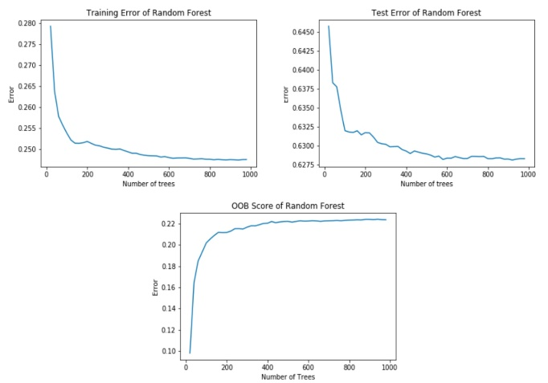
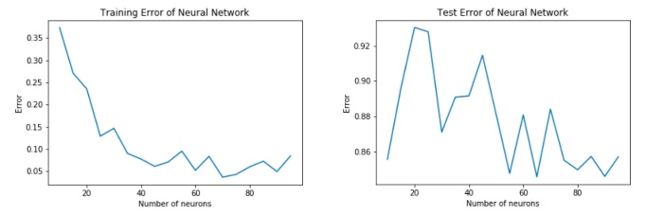
Experiment
We use MLPRegressor from scikit-learn library to build the multilayer perceptron model. We optimize this neural network by varying its hyperparameters and activation function to achieve minimum loss measured by RMSD. The optimal multilayer perceptron in this study has 90 neurons in its hidden layer with initial learning rate at 0.005 and the logistic sigmoid function as the activation function.
Figure 2. Training Error and Test Error of the Neural Network Model
Figure 1. Training Error, Test Error, and OOB score of the Random Forest Model
ZJU-UIUC Institute © 2020-2021 Yucheng Jin. All rights reserved. Slide

Slide 11
Experimental Results and Analysis
Linear Regression
The importance of each factor is scaled by the absolute value of its weight listed below in Table II.
From Table II, the principal factors that have the most positive effect on Chinese junior high school students’ academic performance mainly lie in the Demographic category, and parents apparently play a decisive role.
These factors appear reasonable as China has preferential policies for minority students, and being a party member and having a bachelor’s degree generally reflects a well-educated family background.
Table 2. Top 10 Principal Factors Discovered
by the Linear Regression Model
Variable | Meaning | Weight
w2a05 | 0-Student is not the only child of the family 1-Student is the only child of the family | -0.162356
w2a17 | 0-Parents get along very well 1-Parents do not get along very well | -0.120932
w2a01 | 0-Student’s Hukou is in the local county 1-Student’s Hukou is not in the local county | -0.094967
w2ba2602.1 | 0-Parents often discuss the relationship between his/her child and his/her friends 1-Parents do not often discuss the relationship between his/her child and his/her friends | -0.093424
w2be11 | 0-Mother is Han Chinese 1-Mother is ethnic minority | 0.065215
w2ba2602 | 0-Parents often discuss with their child things happened in school 1-Parents do not often discuss with their child things happened in school | -0.057533
w2ba32.1 | 0-Parents do not choose “Not confident at all” with respect to their child’s future 1-Parents choose “Not confident at all” with respect to their child’s future | -0.056092
w2be16 | 0-Mother is not a member of the CCP 1-Mother is a member of the CCP | 0.054267
w2ba32.2 | 0-Parents do not choose “Not so confident” with respect to their child’s future 1-Parents choose “Not so confident” with respect to their child’s future | -0.050167
w2be08 | 0-Father does not have Bachelor degree 1-Father has Bachelor degree | 0.045347
ZJU-UIUC Institute © 2020-2021 Yucheng Jin. All rights reserved. Slide

Slide 12
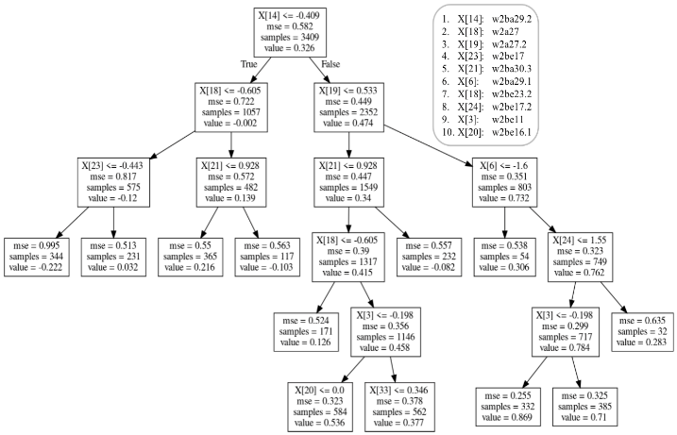
Experimental Results and Analysis
Regression Tree
The importance is measured by the Gini importance.
The major difference between Table 2 and 3 is that variables in Table 3 are all related to parents instead of students.
Table 3. Top 10 Principal Factors Discovered by the Regression Tree Model
Variable | Meaning | Weight
w2ba29.2 | 0-Parents do not expect Master/PhD degree as highest level of education 1-Parents expects Master/PhD degree as highest level of education | 0.452754
w2a27 | 0-Parents’ requirement on their child’s academic record is not “Top five of the class” 1-Parents’ requirement on their child’s academic record is “Top five of the class” | 0.183637
w2a27.2 | 0-Parents’ requirement on their child’s academic record is not “About average” 1-Parents’ requirement on their child’s academic record is “About average” | 0.141884
w2be17 | 0-Mother does not have Bachelor degree 1-Mother has Bachelor degree | 0.120624
w2ba30.3 | 0-Parents do not most expect their child to become “Government official, staff of public institutions, civil servant”, “Manager or administrator of companies”, or “Scientist/engineer/programmer/pilot” in the future 1-Parents most expects their child to become “Government official, staff of public institutions, civil servant”, “Manager or administrator of companies”, or “Scientist/ engineer/programmer/pilot” in the future | 0.031678
w2ba29.1 | 0-Parents do not expect Bachelor degree as highest level of education 1-Parents expects Bachelor degree as highest level of education | 0.025605
w2ba23.2 | 0-Family’s economic status is not at least “Moderate” 1-Family’s economic status is at least “Moderate” | 0.019219
w2be08 | 0-Father does not have Bachelor degree 1-Father has Bachelor degree | 0.016788
w2ba11 | 0-Mother is Han Chinese 1-Mother is ethnic minority | 0.007810
w2be07 | 0-Father is not a member of the CCP 1-Father is a member of the CCP | 0.007569
Figure 3. Regression Tree
ZJU-UIUC Institute © 2020-2021 Yucheng Jin. All rights reserved. Slide

Slide 13
Experimental Results and Analysis
Random Forest
The importance is measured by the Gini importance.
Compared to Table 2 and 3, Table 4 not only indicates parents’ influence on their child, but also emphasizes the importance of a student’s self-expectation—students with higher expectation for education and students under higher academic pressure have higher possibility to succeed.
Table 4. Top 10 Principal Factors Discovered by the Random Forest Model
Variable | Meaning | Weight
w2b18.2 | 0-Student does not expect Master/PhD degree as highest level of education 1-Student expects Master/PhD degree as highest level of education | 0.052732
w2a27.2 | 0-Parents’ requirement on their child’s academic record is not “About average” 1-Parents’ requirement on their child’s academic record is “About average” | 0.040803
w2a27 | 0-Parents’ requirement on their child’s academic record is not “Top five of the class” 1-Parents’ requirement on their child’s academic record is “Top five of the class” | 0.040789
w2ba29.2 | 0-Parents do not expect Master/PhD degree as highest level of education 1-Parents expects Master/PhD degree as highest level of education | 0.021094
w2a29.4 | 0-Student does not feel “Very stressed” about parents’ expectation 1-Student feels “Very stressed” about parents’ expectation | 0.011729
w2bc0204 | 0-Student did not receive government’s subsidies last semester 1-Student received government’s subsidies last semester | 0.011444
w2a28.2 | 0-Parents do not expect Master/PhD degree as highest level of education 1-Parents expect Master/PhD degree as highest level of education | 0.011311
w2a27.1 | 0-Parents’ requirement on their child’s academic record is not “Above average” 1-Parents’ requirement on their child’s academic record is “Above average” | 0.009826
w2be02 | 0-Father is Han Chinese 1-Father is ethnic minority | 0.007619
w2be16 | 0-Mother is not a member of the CCP 1-Mother is a member of the CCP | 0.007557
ZJU-UIUC Institute © 2020-2021 Yucheng Jin. All rights reserved. Slide

Slide 14
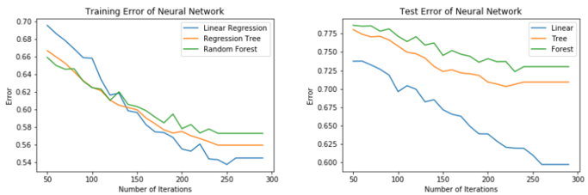
Experimental Results and Analysis
Comparison of Principal Factors with Respect to Different EDM Techniques
After finishing the data mining process, we further evaluate the predictive performance of each set of principal factors by implementing the optimal multilayer perceptron neural network obtained from the experimental setup.
Fig. 4 demonstrates the principal factors selected by linear regression make training error and test error of the multilayer perceptron smallest, while the principal factors selected by random forest give the worst predictive performance.
Comparison of Principal Factors with Respect to Different Target Variables
We change the target variable from students’ standardized total exam scores to their cognitive test scores and standardized math, Chinese, and English exam scores for further investigation.
The results indicate that as for cognitive test scores, Willingness accounts for the majority of principal factors; as for Chinese and English scores, the majority of principal factors are in the Interaction category; while math score is largely influenced by the Demographic variables.
Figure 4. Predictive Performance Comparison of the Three Principal Factor Sets
ZJU-UIUC Institute © 2020-2021 Yucheng Jin. All rights reserved. Slide

Slide 15
Conclusion and Future Work
Conclusion
The linear regression model indicates that parents play a decisive role in their child’s academic performance and reflects the significance of a student’s Hukou status.
The regression tree model further consolidates the importance of parents, while the random forest model shows that a student’s self-expectation for education is also significant to his/her academic success.
The multilayer perceptron shows the principal factors selected by linear regression achieve the best predictive performance, while the principal factors selected by random forest give the worst predictive performance.
Future Work
More EDM techniques such as Hidden Markov Model (HMM) and collaborative filtering [7] could be applied.
More datasets from different countries or regions could be taken into consideration.
More real-world educational surveys may be designed to substantiate the correctness of our findings.
ZJU-UIUC Institute © 2020-2021 Yucheng Jin. All rights reserved. Slide

Slide 16
References
[1] C. Romero and S. Ventura. “Educational data mining: A survey from 1995 to 2005”. Expert Systems with Applications, 33.1(2007): 135-146.
[2] Sung Ho Ha, S. M. Bae, and S. C. Park. “Web mining for distance education”. IEEE International Conference on Management of Innovation and Technology IEEE, 2000.
[3] Q. A. Al-Radaideh, E. W. AI-Shawakfa, and M. I. AI-Najjar. “Mining student data using decision trees”. International Arab Conference on Information Technology (ACIT), Yarmouk University, Jordan, 2006.
[4] Surjeet Kumar Yadav, B. Bharadwaj, and S. Pal. “Data Mining Applications: A Comparative Study for Predicting Student’s Performance”. International Journal of Innovative Technology and Creative Engineering, Vol.1 No.12 (2011): 13-19.
[5] B. K. Bharadwaj and S. Pal. “Data Mining: A prediction for performance improvement using classiﬁcation”. International Journal of Computer Science and Information Security (IJCSIS), Vol.9 No.4 (2011): 136-140.
[6] Jiawei Han and M. Kamber. “Data Mining: Concepts and Techniques”. The Morgan Kaufmann Series in Data Management Systems, 2000.
[7] Alejandro Pe˜na-Ayala. “Electron spectroscopy studies on magnetooptical media and plastic substrate interface”. Expert Systems with Applications: An International Journal, Vol.41 No.4 (2014): 1432–1462.
[8] Di Xu and Qiujie Li. “Gender achievement gaps among Chinese middle school students and the role of teachers’ gender”. Economics of Education Review, Vol.67 (2018): 82-93.
[9] T. Hastie, R. Tibshirani, and J. Friedman. “The Elements of Statistical Learning (Second Edition, Corrected 12th Printing)”. Springer New York Inc., 2017.
ZJU-UIUC Institute © 2020-2021 Yucheng Jin. All rights reserved. Slide

Slide 17
Thank You!
ZJU-UIUC Institute © 2020-2021 Yucheng Jin. All rights reserved. Slide

